Slide 1
ECE 884 Deep Learning
Lecture 5: Parametric Models
02/02/2021

Slide 2
Review of last lecture
Function form#1: nonparametric models

Slide 3
Today’s lecture
Function form#2: parametric linear models
Function form#3: parametric nonlinear models (DL models)
Understand why deep learning models are powerful and importance of massive computation and large data sets.

Slide 4
Today’s lecture
Function form#2: parametric linear models

Slide 5

Parametric Approach
Image
10 numbers giving class scores
f(x,W)
Array of 32x32x3 numbers (3072 numbers total)
W
parameters or weights
Credit: Justin

Slide 6
f(x,W) = Wx
Parametric Approach: Linear Classifier
Image
10 numbers giving class scores
f(x,W)
Array of 32x32x3 numbers (3072 numbers total)
W
parameters or weights
Credit: Justin

Slide 7
Parametric Approach: Linear Classifier
(3072,)
f(x,W) = Wx
Image
(10,) (10, 3072)
f(x,W)
10 numbers giving class scores
Array of 32x32x3 numbers (3072 numbers total)
W
parameters or weights
Credit: Justin

Slide 8
Parametric Approach: Linear Classifier
(3072,)
f(x,W) = Wx + b
(10,)
Image
(10,) (10, 3072)
f(x,W)
10 numbers giving class scores
Array of 32x32x3 numbers (3072 numbers total)
W
parameters or weights
Credit: Justin

Slide 9

Example for 2x2 image, 3 classes (cat/dog/ship)
Stretch pixels into column
f(x,W) = Wx + b
56
231
24
2
56 | 231
24 | 2
Input image (2, 2)
(4,)
Credit: Justin

Slide 10
Example for 2x2 image, 3 classes (cat/dog/ship)
Stretch pixels into column
f(x,W) = Wx + b
56
231
24
2
0.2 | -0.5 | 0.1 | 2.0
1.5 | 1.3 | 2.1 | 0.0
0 | 0.25 | 0.2 | -0.3
1.1
3.2
-1.2
-96.8
437.9
61.95
56 | 231
24 | 2
+ =
Input image (2, 2)
W (3, 4)
b
(3,)
(3,)
(4,)
Credit: Justin

Slide 11
Linear Classifier: Algebraic Viewpoint
Stretch pixels into column
f(x,W) = Wx + b
56
231
24
2
0.2 | -0.5 | 0.1 | 2.0
1.5 | 1.3 | 2.1 | 0.0
0 | 0.25 | 0.2 | -0.3
1.1
3.2
-1.2
-96.8
437.9
61.95
56 | 231
24 | 2
+ =
Input image (2, 2)
W (3, 4)
b
(3,)
(3,)
(4,)
Credit: Justin

Slide 12
Linear Classifier: Bias Trick
Add extra one to data vector; bias is absorbed into last column of weight matrix
Stretch pixels into column
56
231
24
2
1
0.2 | -0.5 | 0.1 | 2.0 | 1.1
1.5 | 1.3 | 2.1 | 0.0 | 3.2
0 | 0.25 | 0.2 | -0.3 | -1.2
-96.8
437.9
61.95
56 | 231
24 | 2
=
Input image (2, 2)
W (3, 5)
(3,)
(5,)
Credit: Justin

Slide 13
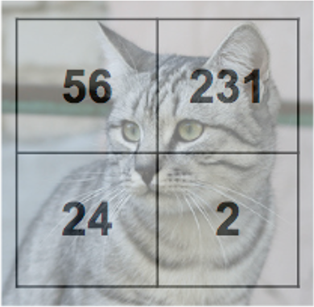

Interpreting a Linear Classifier
Instead of stretching pixels into columns, we can equivalently stretch rows of W into images!
Algebraic Viewpoint f(x,W) = Wx + b
Stretch pixels into column
0.2 | -0.5
0.1 | 2.0
1.5 | 1.3
2.1 | 0.0
0 | .25
0.2 | -0.3
56
231
24
2
W
+ =
56 | 231
24 | 2
0.2 | -0.5 | 0.1 | 2.0
1.5 | 1.3 | 2.1 | 0.0
0 | 0.25 | 0.2 | -0.3
1.1
3.2
-1.2
-96.8
437.9
61.95
Input image (2, 2)
W (3, 4)
b
1.1
3.2
-1.2
b
(3,)
(3,)
(4,)
-96.8
437.9
61.95
Credit: Justin

Slide 14
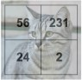
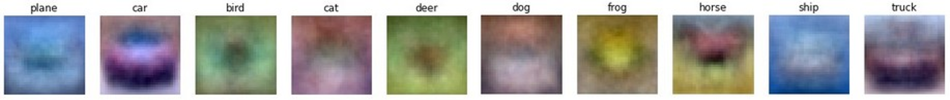
Interpreting an Linear Classifier: Visual Viewpoint
Linear classifier has one “template” per category
W
b
0.2 | -0.5
0.1 | 2.0
1.5 | 1.3
2.1 | 0.0
0 | .25
0.2 | -0.3
 | 1.1 |  |  |  | 3.2 |  |  |  | -1.2
 | -96.8 |  |  |  | 437.9 |  |  |  | 61.95
Credit: Justin

Slide 15

Interpreting a Linear Classifier: Geometric Viewpoint
Airplane
Score
f(x,W) = Wx + b
Car Score
Cat Score
Classifier score
Array of 32x32x3 numbers (3072 numbers total)
Value of pixel (15, 8, 0)
Credit: Justin

Slide 16
Interpreting a Linear Classifier: Geometric Viewpoint
Decision Regions
Airplane
Score
f(x,W) = Wx + b
Car Score
Cat Score
Classifier score
Array of 32x32x3 numbers (3072 numbers total)
Value of pixel (15, 8, 0)
Credit: Justin

Slide 17
Hard Cases for a Linear Classifier
Class 1:
First and third quadrants
Class 1:
1 <= L2 norm <= 2
Class 2: Everything else
Class 1: Three modes
Class 2: Everything else
Class 2:
Second and fourth quadrants
Credit: Justin

Slide 18
Non-parametric model
+ As the number of training samples goes to infinity, nearest neighbor can represent any^{(*)} function!
- You need to carry all the data: curse of dimensionality!
Linear parametric model
+ We have a function now, and we do not need to carry all the data!
- Its capability is limited!

Slide 19
Can we combine the advantages of both worlds and get rid of their drawbacks?

Slide 20
Today’s lecture
Function form#3: parametric nonlinear models (DL models)
Understand why deep learning models are powerful and importance of massive computation and large data sets.

Slide 21
Model + Data + Computational Power
Model
Deep Learning
Data
Computational Power

Slide 22
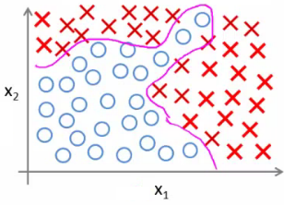

Model
Deep Learning Models
Traditional Linear Machine Learning Model

Slide 23
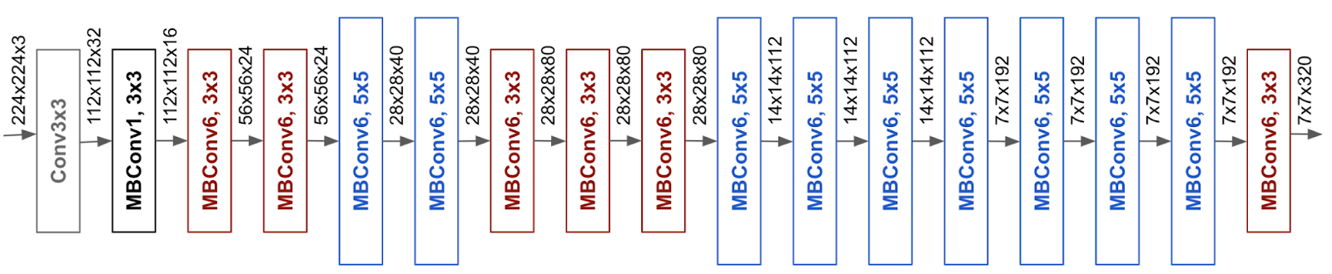
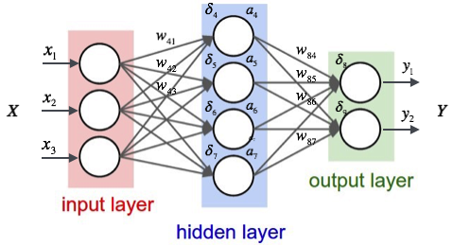
Model
Deep Learning Models
Traditional Nonlinear Machine Learning Model

Slide 24
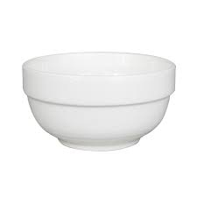
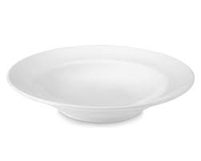
Model
Deep Learning Models
Traditional Machine Learning Model

Slide 25
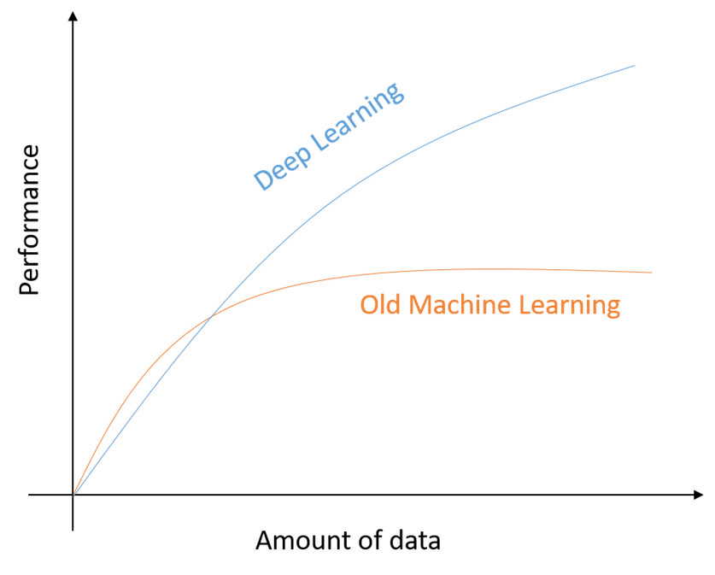
Data

Slide 26
Data
Old Days

Slide 27
Data
Today

Slide 28
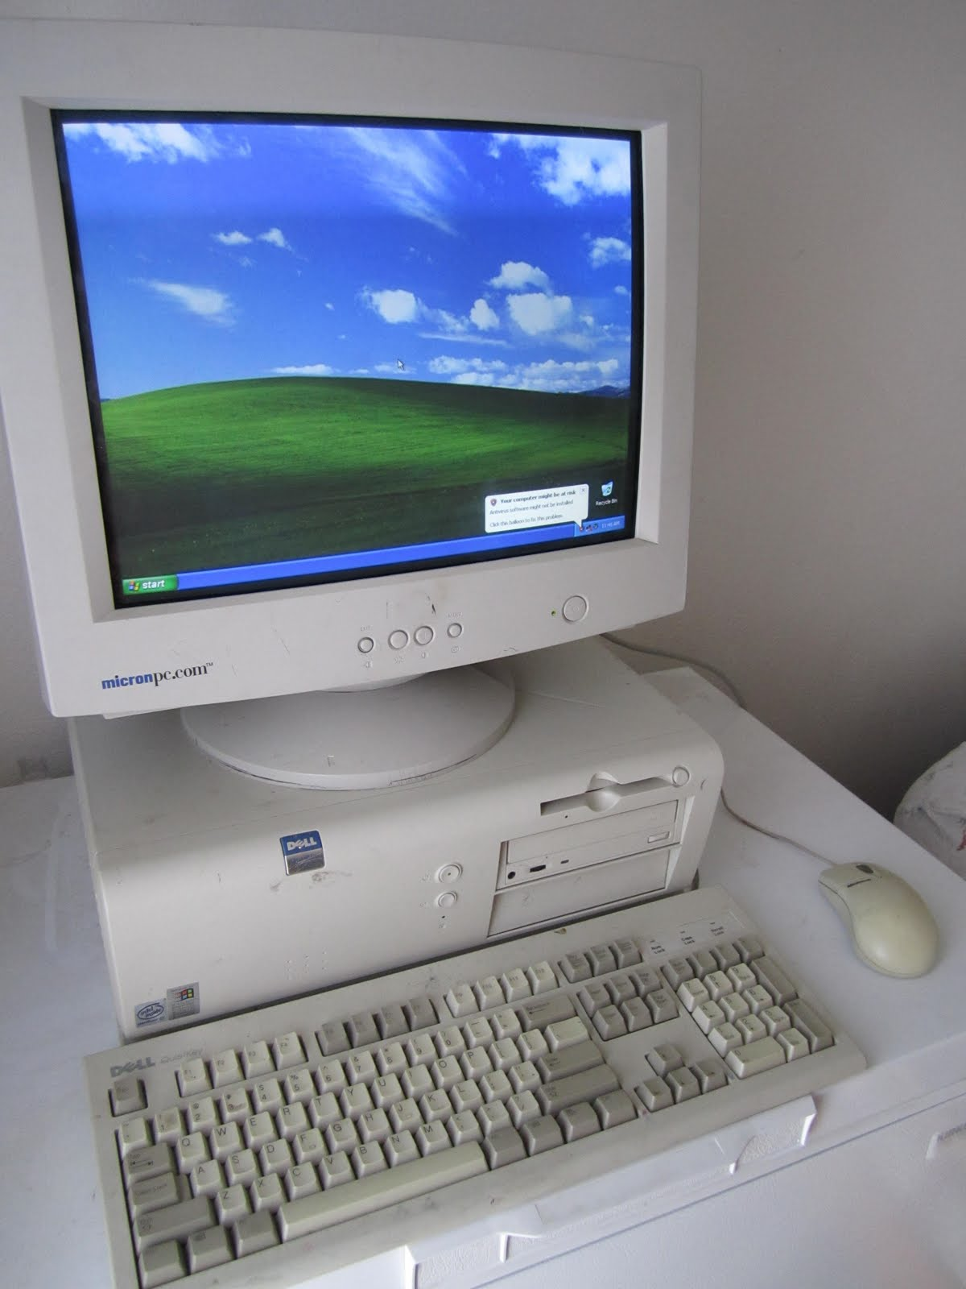
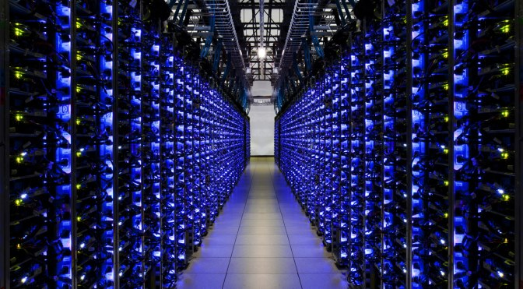
Computational Power
Old Days
Today

Slide 29
Model + Data + Computational Power -> Success of Deep Learning
Model
Deep Learning
Data
Computational Power

Slide 30
Any Question ?

